Slide 1
DDR4 Simulation
Ben Huntsman, Jeff nguyen, jon vlas

Slide 2
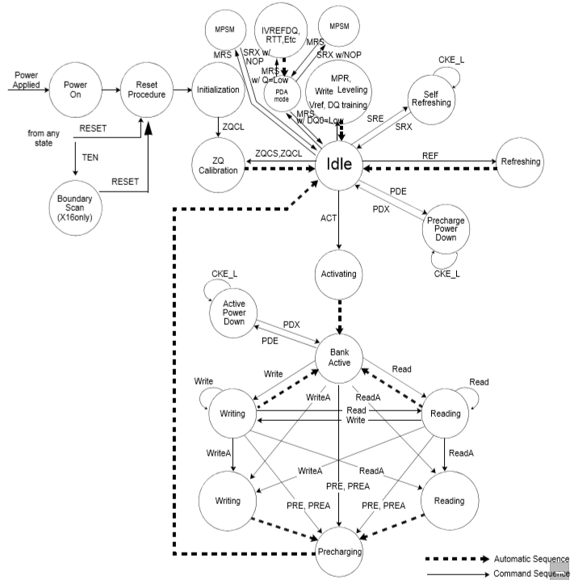
DDR4 FSM
Initialization
Idle
Activating
R/W Loop

Slide 3
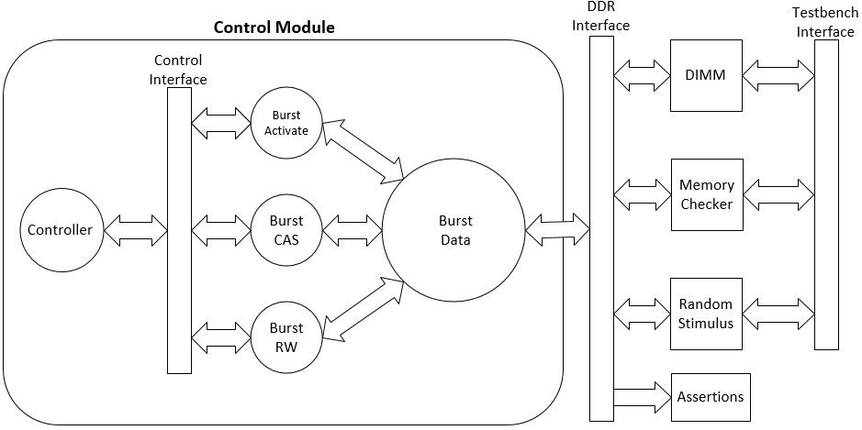
Major Components

Slide 4
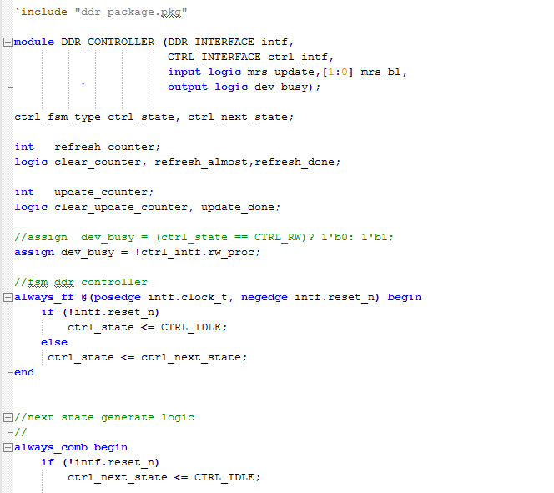
Control Module
Controller
Burst Activate
Burst CAS
Burst R/W
Burst Data

Slide 5
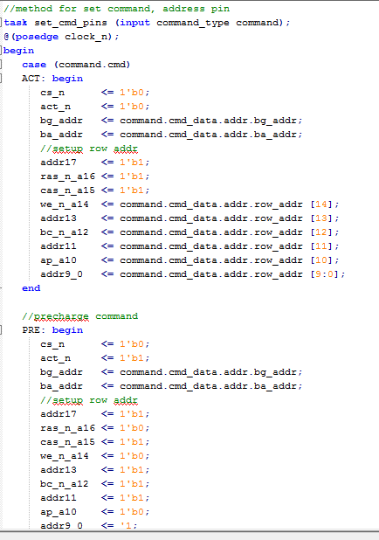
Interfaces
DDR
Control
Testbench

Slide 6
Dimm
4GB Model

Slide 7
Assertions

Slide 8
Test Stimulus
Direct
Corners of DIMM, every group, every bank
Consecutive writes same row followed by write to different row in same bank
Consecutive reads same row followed by read to different row in same bank
Randomized
2 Classes
Constraints for op code
50/50 – R/W distribution
Ensure that we only read from address that we have previously written to.

Slide 9
Questions?

